Slide 1
Introduction to Identity Management

Slide 2
Identity
A set of attributes that define an entity
  An entity is a thing with distinct and independent existence
In database management systems:
  Entity: A unique object in the real world that. Examples include single person, single product, or single organization.
  Entity type: Type of information stored in a table(s). Includes person, organization, object type, or concept
  Attribute: A characteristic or trait of an entity type that describes the entity, for example, the Person entity type has the Date of Birth attribute.
Notes:
- Object Oriented concepts
- Object has attributes – define the state of an object at a point in time

Slide 3
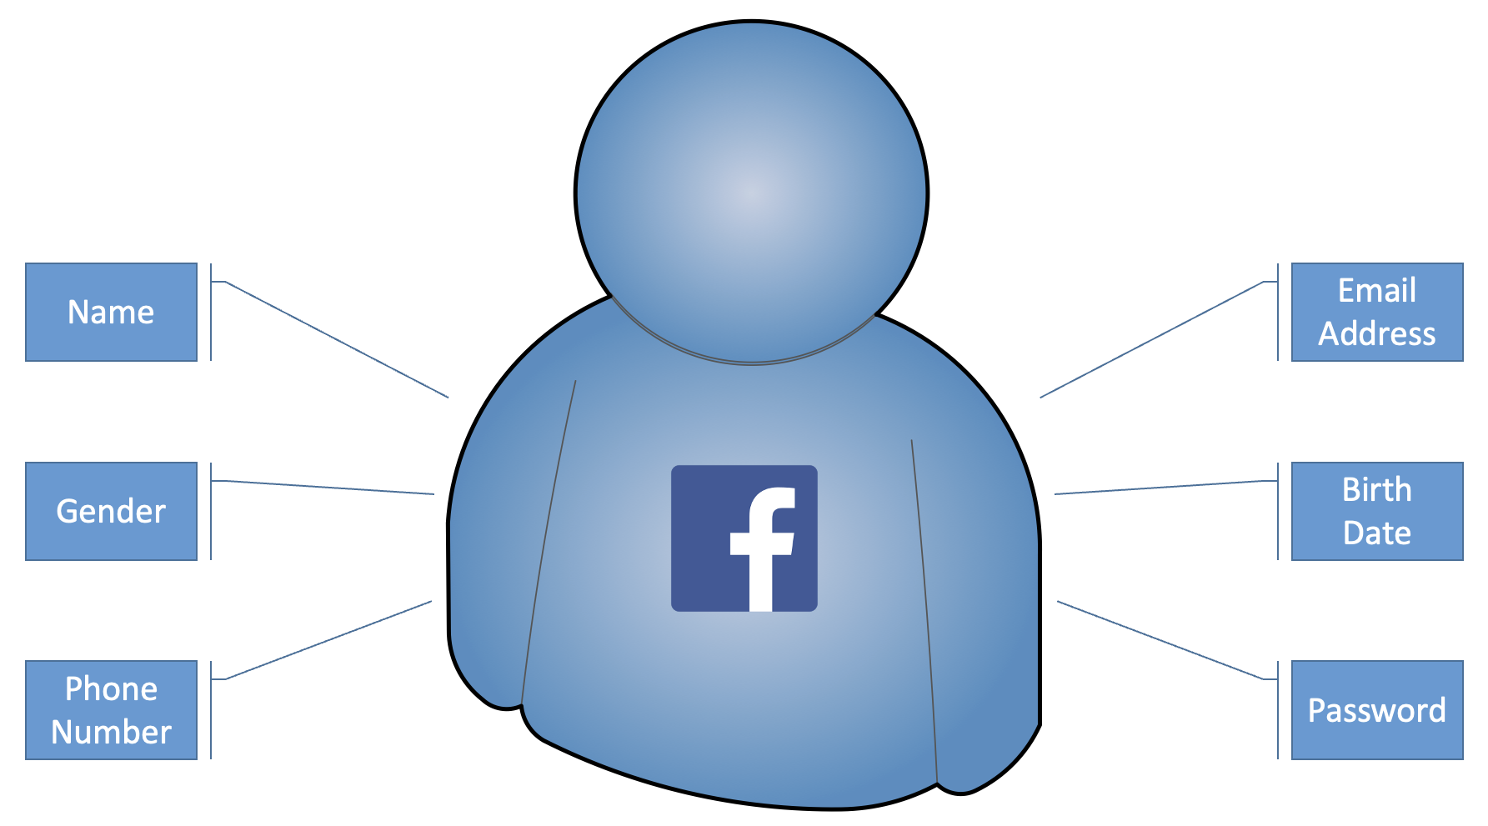
Identity (Facebook)

Slide 4
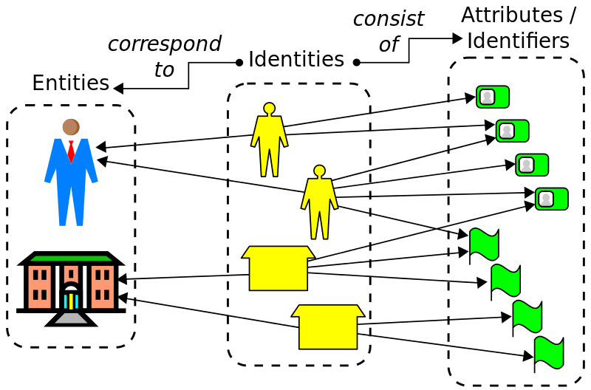
Identity

Slide 5
Digital Identity
What do you already know about your users?
  Students
    Student number / identifier
    Name
    Address
    Qualifications
    Course registration
    Marks, exam results
    Password
    Email address
    ………

Slide 6
Digital Identity
What do you already know about your users?
  Staff
    Employee number / identifier
    Name, address, phone number
    Contract status/type
    Password
    Email address
    Faculty, department, division
    Committee membership
    ………

Slide 7
Digital Identity
What do you already know about your users?
  Academic & Research
    Current research
    Grants
    Publications, research output?
    ………

Slide 8
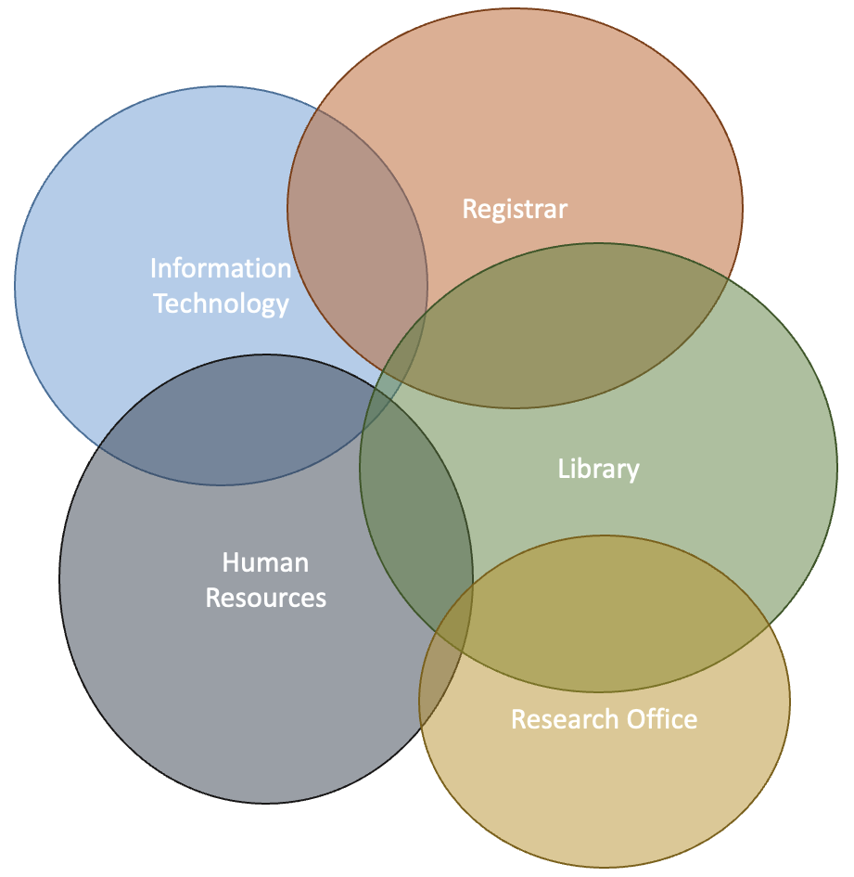
Digital Identity
Staff
Students
Academic & Research

Slide 9
Digital Identity Systems
Active Directory
Student records
Human resources/employee management
Payroll
Current research information system (CRIS)
Grant management system
Institutional repositories
Alumni relations
…

Slide 10
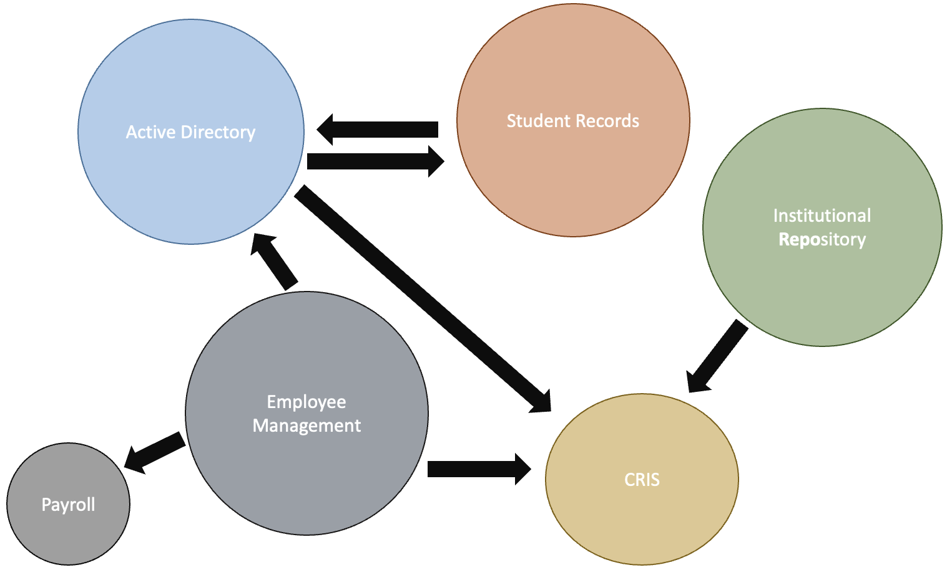
Digital Identity Systems

Slide 11
Identity Management (IdM)
Also known as Identity & Access Management (IAM)
  Organizational structures, policies and processes to administer and manage IT resources such as data
    Authentication & Authorization
    User Management
    Directory Services
Right entities can access tools required to perform their work
  Appropriate | Required level of access

Slide 12
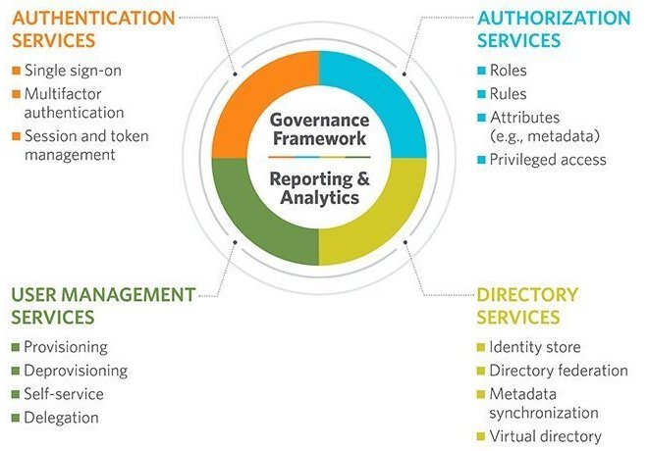
Identity Management (IdM)

Slide 13
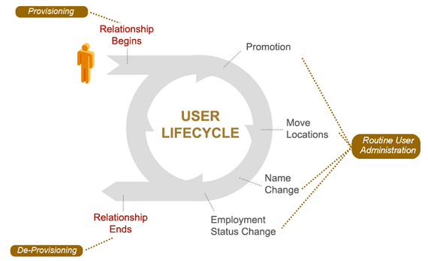
Identity Management Lifecycle

Slide 14
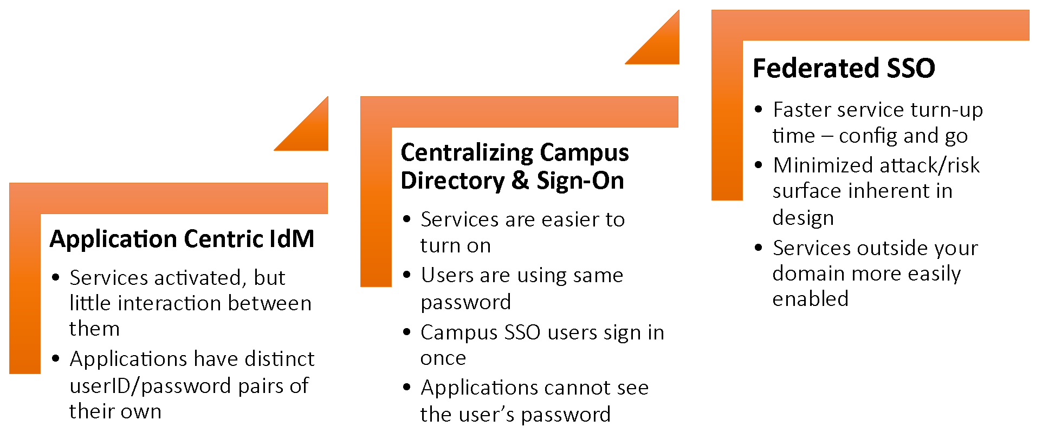
Evolution of Identity Techniques

Slide 15
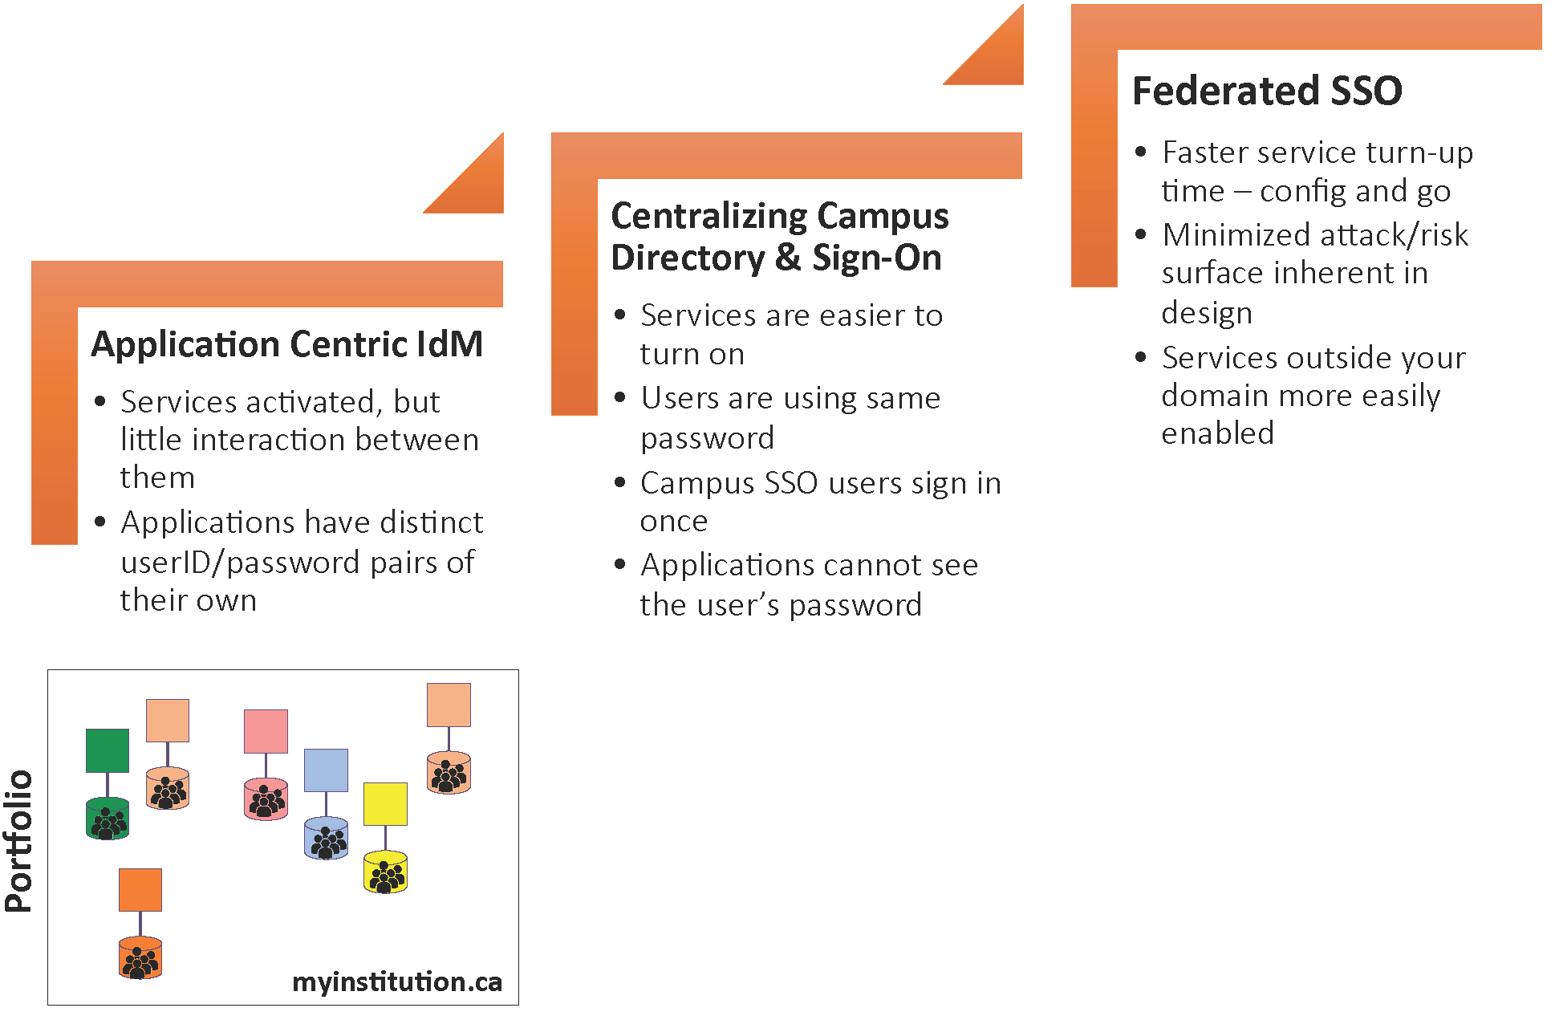
Evolution of Identity Techniques

Slide 16
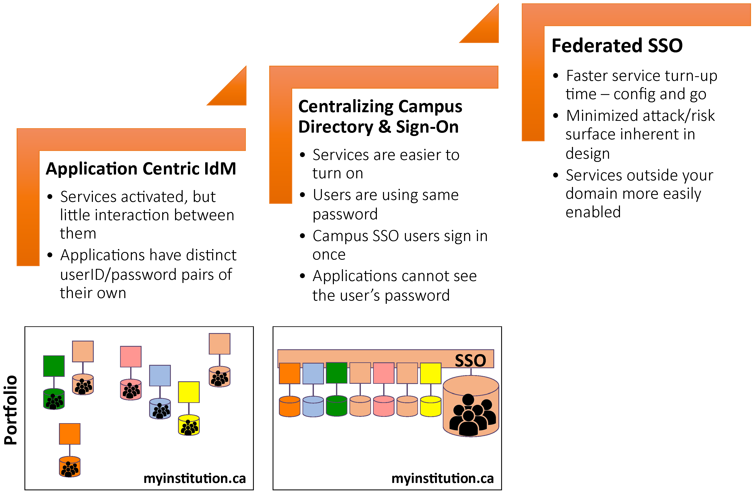
Evolution of Identity Techniques
What is needed to get to this stage?

Slide 17
Identity Management - Centralized
What is needed to get to this stage?
If not yet, conduct an institution-wide audit of identity to determine who has what attributes
Determine the authority for each attribute, e.g:
  Email address -> IT department
  Student numbers -> Registrar
  Student name -> Registrar
  Staff name -> Human resources
Determine consumers for each attribute
Determine what constraints exist for each attribute:
  Name field is 100 chars at authority, but CRIS system only accepts 80 chars

Slide 18
Identity Management - Centralized
What is needed to get to this stage?
You probably already have some processes to share information between departments, but:
  Make sure these are aligned with the audit results (right authority)
  Use common language and descriptions (what do we mean by givenName?)
  Start aligning the constraints (if smallest name field is 80 chars and this cannot be changed, use 80 char names)
  Introduce update processes to ensure identities remain in sync (all consumers are told when a change happens at the authority)

Slide 19
Identity Management - Centralized
What is needed to get to this stage?
You need institutional buy-in – can be hard to get
Take small steps, easy wins
  but do not lose sight of the big picture
These interim steps do not need to depend on technology
Consider identity registry / vault system

Slide 20
Registry
All details in Active Directory (AD)

Slide 21
Registry
Use a Person registry
Active Directory – consumer of identity

Slide 22
Registry
Remember we spoke about authorities? These feed your registry…
  Unique identifier
  Name (from HR)
  Email address (from IT)
  Employee number (from HR)

Slide 23





Registry
Software
  NetIQ (Novell) Identity Manager
  Microsoft Identity Manager (MIM)
  IBM Tivoli Identity Manager
  Oracle Identity Manager
  RENU/UA Managed IdP
  OpenIAM
  Apache Syncope
  FreeIPA
  OpenLDAP
Notes:
Open Source
Cloud or On-premise

Slide 24
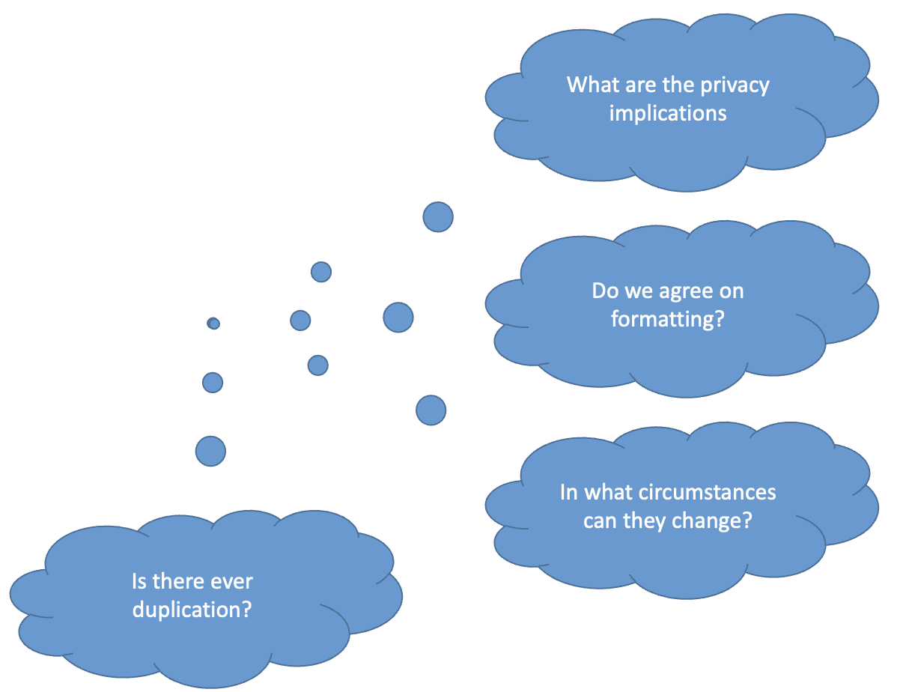
Person Identifiers
Username
National ID
Passport number
Student number
Employee/staff number
Email address?
ORCID iD

Slide 25
Person Identifiers
Attributes of a good Person Identifier?
Concepts/Terminology
  Persistent vs transient (for Name identifiers)
  Transferable / reassignment
  Unique
  Pseudo-anonymous – looks anonymous (e.g a user that requested for X….)
  Opaque & Pseudonym – randomly map/link identities
  Targeted
Notes:
eduPersonTargetedID - A persistent, non-reassigned, opaque identifier for a principal
Transient – random and privacy-preserving while persistent sends actual identity

Slide 26
Person Identifiers
Privacy-preserving Identifiers
  Should be generated
    not the same as the identifier in your person registry/directory
  Must be opaque and uni-directional
    e.g. a SHA-256 hash
Think about making them targeted

Slide 27

Person Identifiers
ORCID
  Open Researcher and Contributor Identifier
  http://orcid.org/0000-0003-4683-1531
  Persistent, opaque
  Institutionally independent
  Like a DOI for people

Slide 28
Person Identifiers
inetOrgPerson
Represents a standard network user
Used by default in most directory services (e.g. Active Directory)
givenName
sn
displayName
mail
ou

Slide 29

Person Identifiers
eduPerson
Person schema for higher education
eduPersonPrincipalName
eduPersonAffiliation
eduPersonScopedAffiliation
eduPersonOrcid
eduPersonEntitlement
Notes:
https://www.internet2.edu/products-services/trust-identity/eduperson-eduorg/

Slide 30
Person Identifiers
eduPerson
Person schema for higher education
eduPersonPrincipalName – Scoped identifier for a person such as hputter@mak.ac.ug
eduPersonAffiliation - Specifies the person's relationship(s) to the institution in broad categories [Next]
eduPersonScopedAffiliation – Scoped affiliation such as alum@ucu.ac.ug
eduPersonOrcid – As before such as 0000-0003-4683-1531
eduPersonEntitlement – controlled access to IT resources
Notes:
https://www.internet2.edu/products-services/trust-identity/eduperson-eduorg/

Slide 31
Person Identifiers
eduPerson Scoping
How to make a person unique
Use DNS
  RADIUS does this with realms
An Example
  user@staff.renu.ac.ug
Notes:
https://www.internet2.edu/products-services/trust-identity/eduperson-eduorg/

Slide 32
Person Identifiers
eduPerson Vocabulary - Affiliation
alum
affiliate
employee
faculty
library-walk-in
member
staff
student

Slide 33
Person Identifiers
eduPerson Entitlement
Widely used by library providers
But slowly being superseded by eduPersonScopedAffiliation
urn:mace:dir:entitlement:common-lib-terms

Slide 34
Access Control
Groups (GBAC)
Attributes (ABAC)
Roles (RBAC)

Slide 35
OpenLDAP - Fundamentals
Identities (principals): users, machines, services/applications
Authentication: /etc/passwd, LDAP, NIS, Kerberos
Authorization: Policies, ACLs, DAC, MAC
Within or across systems: all this can be configured locally
  May become a synchronization nightmare on network
Notes:
NIS is a distributed database system that lets many computers share password files, group files, host tables, and other files over the network. Although the files appear to be available on every computer, they are actually stored on only a single computer, called the NIS master server (and possibly replicated on a backup, secondary server, or slave server ). The other computers on the network, NIS clients, can use the databases (such as /etc/passwd) stored on the master server as if they were stored locally. These databases are called NIS maps.

Slide 36
FreeIPA Concepts
Active Directory
  Main identity management solution deployed in more than 90% of the enterprises
LDAP (389 DS, OpenLDAP, eDirectory, SunDS, ...)
  Often used for custom IdM solution
Kerberos
  Authentication
Samba (Samba 4 DC, Samba FS, Winbind)
NIS (NIS+) - obsoleted

Slide 37
FreeIPA Concepts
Why is Active Directory so popular?
  Integrated solution
  It is relatively easy to use
  Simple configuration for clients
  All the complexity is hidden from users and admins - Comprehensive interfaces
And Open Source tools?
  Solve individual problems - “do one thing and do it well”
  Bag of technologies lacking integration
  Hard to install and configure - manual LDAP+Kerberos configuration?
  Too many options exposed - Which to choose?
  Lack of good user interfaces

Slide 38
FreeIPA
Free Identity, Policy, Audit
Makes it simpler to manage complex IAM problems
  Manual LDAP Kerberos implementation?
Uses standard protocols and components
Central Management
Gateway between Linux infrastructure and Active Directory (AD)
  AD is deployed by over 90% of the enterprises
Can be used by almost anyone
  Managers, Administrators, Users, …….
Notes:
Kerberos is a network authentication protocol. It is designed to provide strong authentication for client/server applications by using secret-key cryptography.

Slide 39
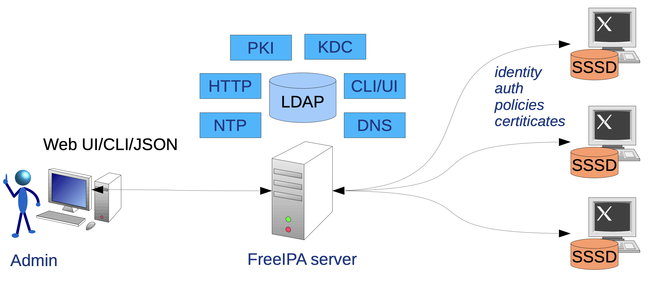
FreeIPA - Architecture
Notes:
SSSD – System Security Services Daemon - Software originally developed for the Linux operating system that provides a set of daemons to manage access to remote directory services and authentication mechanisms.
KDC – Key Distribution Center – Provide keys to network users
PKI – Public Key Infrastructure
NTP –
HTTP –

Slide 40
FreeIPA
Installation
SSO – with FreeIPA

