Slide 1
Federation Architectures
Alex Mwotil
RENU Identity Federation (RIF)
Notes:
A brief about me

Slide 2
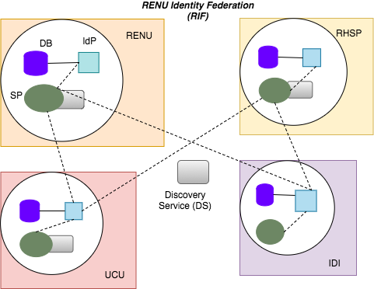
RIF - Full Mesh

Slide 3
RIF - Why full mesh?
Operated by most federations
  More of a standard? - As a new federation, would opt for most popular architecture
Easy to implement
  Support, tools & documentation vastly available
Workload distribution - to the institutions
No single points of failure - no need for a hub
Hub infrastructure costs.. RIF's workforce is part of the main RENU operations
Number of institutions - manageable with this implementation
Usability - intuitiveness with branding information
Learning opportunity? - Trainings approach
Notes:
Failure in UCU, doesn't impact performance of other federation entities

