Slide 1
Nurturing the culture of collaborative ecosystems using real-time communication: sharing experiences from three institutions
BY
PROFESSOR CHRISPEN CHIOME
RESEARCH PROFESSOR
ZIMBABWE OPEN UNIVERSITY

Slide 2
OBJECTIVE is to reach the greener paddock across the river through Nurturing A culture of collaborative ecosystems using real-time communication

Slide 3
Collaborative ecosystem
By 2030, digitization will change the way we live, travel and work
stake your claim in the connected ecosystem now
With an open and secure ecosystem, where collaboration and innovation are encouraged, the possibilities are limitless.

Slide 4
Network of Digital Twins = Connectivity + Communication + Collaboration
Universities operating in a network require strong information technology support to successfully collaborate
information technology platforms are necessary to enhance quick connect capability and to transform University networks into digital ecosystems
WITH REAL-TIME DATA ON YOUR SIDE, YOU CAN:
Conduct ongoing analysis
Respond to demanding customers faster
Enhance product designs
Perform proactive and predictive maintenance
Carry out condition and environmental modeling

Slide 5
Why collaboration?
collaboration with customers, partners or suppliers can yield tremendous competitive advantage
Universities have to use a systematic approach to develop a sound and successful strategy for building collaborative ecosystems and communities
the age of digital collaboration using web-based collaboration space is upon us.
It is through digital collaboration that we can:
work across technologies, across channels and across geographic boundaries
to promote efficiency, effectiveness and productivity in organisations.

Slide 6
Purpose of study: spotting & supporting Collaborative ecosystems
This study examined the experiences of three institutions in using real-time communication to promote the culture of collaborative ecosystems in education.

Slide 7
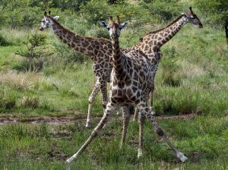
METHODOLOGY
The research was a survey of three institutions in Southern Africa involved in Open and Distance Teaching.
These were purposively sampled.
The research utilised survey monkey questionnaire to gather real-time feedback.

Slide 8
Results: digital collaboration nurtures the culture of collaborative ecosystems
it promotes real-time collaboration
strengthens camaraderie,
is a hub for teamwork,
removes roadblocks to productivity,
enables the use of multiple platforms,
facilitate the integration of tasks,
offer very similar functionalities,
empower employees,
And enable solicitation of end-user feedback among others.

Slide 9
Areas of collaborations in the Universities
Collaboration areas mentioned included:
using mobile-video tools,
video conferencing,
multi-author editing,
continuous communication
and project management among others

Slide 10
collaboration technologies used
Use of appropriate, affordable and compatible collaboration technologies
such as Basecamp,
Google Hangouts,
Skype,
SharePoint,
HipChat,
Microsoft Teams etc were also mentioned.

Slide 11
Platform for collaboration
Use of the right platform
platform integration and adoption
Quote: “management integrates collaboration tools into work processes rather than force work processes to accommodate tools”
The issue of technology acceptance from the shop floor was mentioned.
Staff support in using new software to increase technology adoption.
Capacity building; staff are fully trained, educated and can offer constructive feedback

Slide 12
Research conclusion
This research taught us that, in research:
“Everyone is entitled to his own opinion, but not his own facts.” –This statement is attributed to Senator Patrick Moynihan.

Slide 13
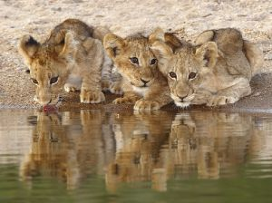
CONCLUSIONs Reached
The research concluded that institutions must keep eyes and ears open, pool their collective skills and resources, foster teamwork and reward digital collaborations to promote productivity.

Slide 14
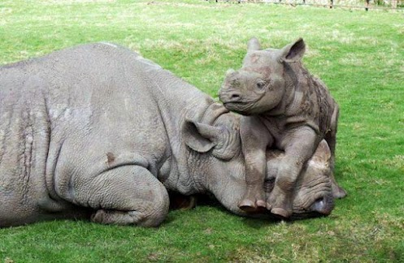
recommendations
institutions must explore collaboration solutions, nurture collaborative culture and integrate digital collaboration into educational operations to promote productivity in the digital era
now is the time to clarify your vision and create a strategy or you will get locked out from reaching your full potential

Slide 15
think not outside the box but without the box altogether

Slide 16
Einsteinian logic: you can’t solve problems at the same level of thinking which applied when you created them in the first place

Slide 17
In Zimbabwe, all researchers, are welcome I thank you

