Slide 1


Challenges for NRENs Technical Training Services: MoRENet Case Study
Republic of Mozambique
Ministry of Science and Technology, Higher and Technical Vocational Education
Mozambique Research and Education Network
(MoRENet)
Prof. Doctor Eng. Lourino Chemane, MoRENet CEO
Eng. Moises Mucelo, MoRENet Academy Manager
01 November 2019
31 October 2019 to 1 November 2019
Madagascar

Slide 2
Agenda
1. Introduction: About MoRENet
2. Research Problem
3. Research Objectives and Methods
4. Case Study: MoRENet Academy
  4.1 Findings
  4.2 Results
  4.3 Challenges, Opportunities and Plans
5. Results and Findings
6. Conclusion

Slide 3
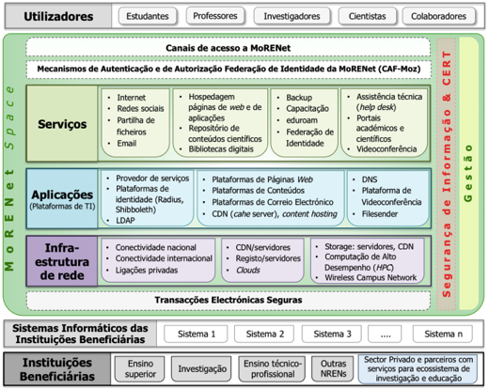
1. Introduction: About MoRENet
MoRENet – Mozambican NREN;
Government supported initiative;
Part of the Mozambique ICT Policy & Implementation Strategy (2002);
MoRENet’s Operations started in 2005;
Founding Member of UbuntuNet;
Connected 160 Academic and Research Institutions.

Slide 4
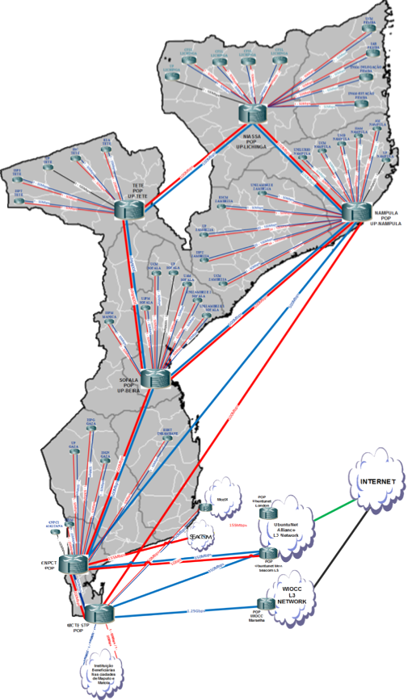
1. Introduction: About MoRENet
Services:
  Connectivity, including Internet Access;
  Hosting of web sites and applications;
  Co-Location;
  E-Mail;
  Eduroam and Identity Federation (CAF-MOZ);
  Hight Performance Computing;
  Virtual Libraries;
  Video and Web Conferences (Zoom)
  Help desk;
  Training (MoRENet Academy);
  Planned: VoIP, File sender, cloud services.

Slide 5
1. Introduction: About MoRENet
MoRENet Operational Areas:
  Network and IT Infrastructure
  System and Applications
  High Performance Computing (HPC)
  Cyber Security and CSIRT
  MoRENet Academy
  Services and contracting
  Administration and Finance

Slide 6
2. Research Problem
The fact: NRENs provides high quality and vast range of services BUT beneficiary institutions do not have the same perception (of quality and availability) and get only very small part of the value proposed by NRENs;
Probable cause: Focal points (local IT staff) at beneficiary institutions are not properly prepared to deliver services and manage NREN services and academic and research community members (students, researchers, and lecturers) are not aware and prepared to harness the benefit of NREN services for the improvement of the teaching, learning and research processes;
Probable reason: Lack of technical skills and knowledge (focal points and end users);
How to address the issue: Prepare the members of the research and academic communities at beneficiary institutions and at NRENs for the NREN services (general ICT and specific to the academic and scientific community) – through training and other capacity building initiatives.

Slide 7


2. Research Problem
NREN
Beneficiary institutions
How prepared are the local staff to:
Make services available
Make services used by the end users
MoRENet
University, Research Institution
Hight trained staff
1 service (area) → 1+ personnel
Dedicated service per person
Multiple institutions to attend
Low/medium trained staff
1 person → all services (local + NREN)
New services (NREN) ➔ few trainings
Focal points (local IT staff)
End users:
Students
Teachers
Researchers
Local Administrative staff
Services (NREN side)
☑ 🙂Quality
☑ 🙂 Availability
Services (institutions side)
🤔 Quality
🤔 Availability

Slide 8
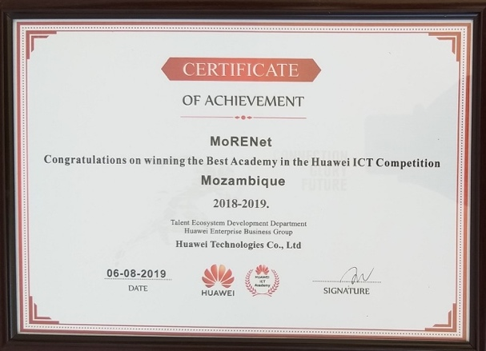
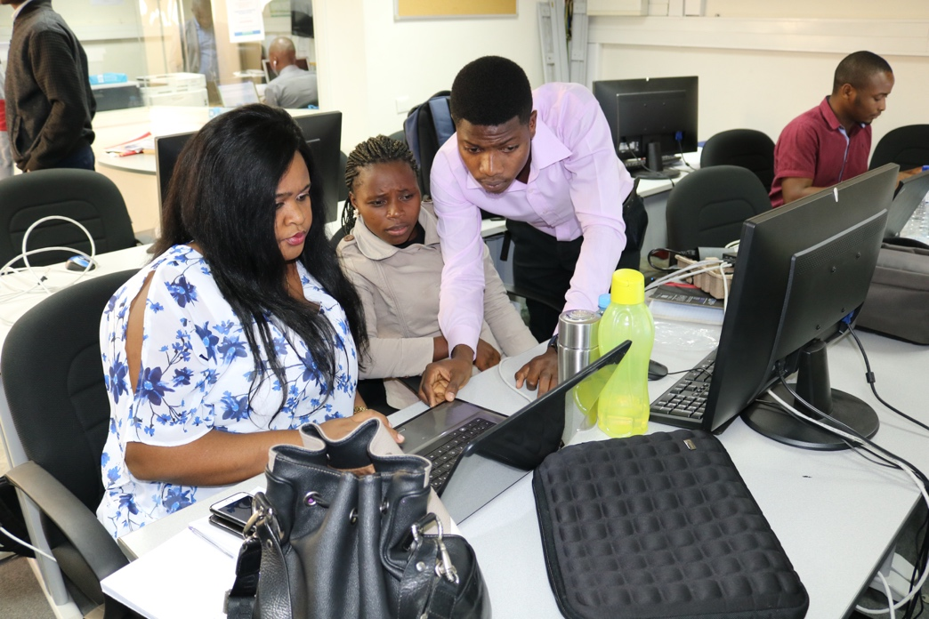
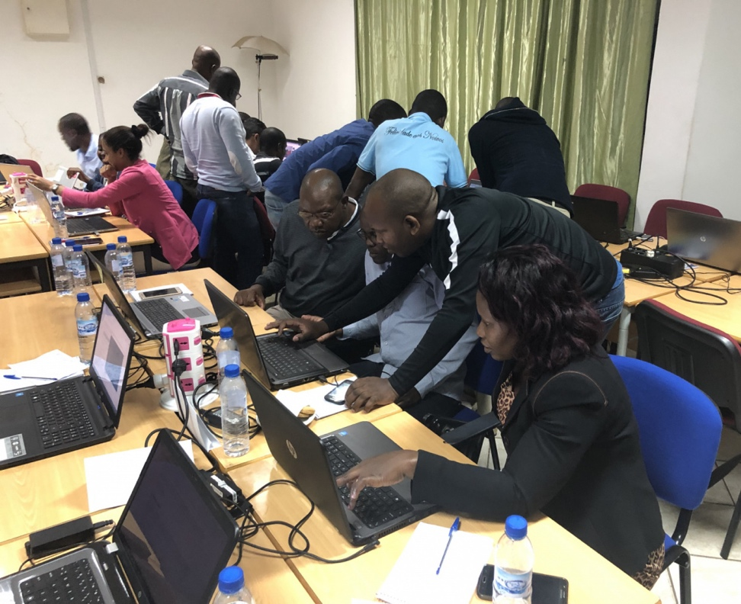
Our Solution
MoRENet Academy
MoRENet Academy – the MoRENet service unit for implementing and supporting capacity building, talent discovery, technological innovation development and ICT knowledge dissemination within the network's beneficiary community.

Slide 9
3. Research Objectives and Methods
Objectives
Evaluate MoRENet Academy's training experience and find the best approaches to offering technical training courses and other capacity building initiatives to meet mass demand;
Find the best alternatives to offer trainings to all (or more) focal points that focus on technical courses;
Improve the quality and availability of NREN's services through training (focal points, IT professionals);
Explore the use of collaboration tools to deliver high quality technical courses.

Slide 10
3. Research Objectives and Methods
Methods
1. Survey/questionnaire addressed to focal points
To meet technical training needs;
Online forms, nationwide;
Type: quantitative.
2. Help desk information – Network Operating Center (NOC)
For technical assistance;
Multi communication ways: WhatsApp, phone calls, email, collaboration tools (Skype, TeamViewer, Videoconferencing, …);
Type: qualitative.
3. Training Results – MoRENet Academy
Trainings database: 2018 and 2019;
Classroom and online trainings.

Slide 11
4. Case Study: MoRENet Academy
Findings
Survey/questionnaire addressed to focal points
Sample: 85 interviewers – focal points from MoRENet connected institutions;
Institutions: Higher Education, Research, TVET;
Nationwide (11 provinces);
Online form.

Slide 12
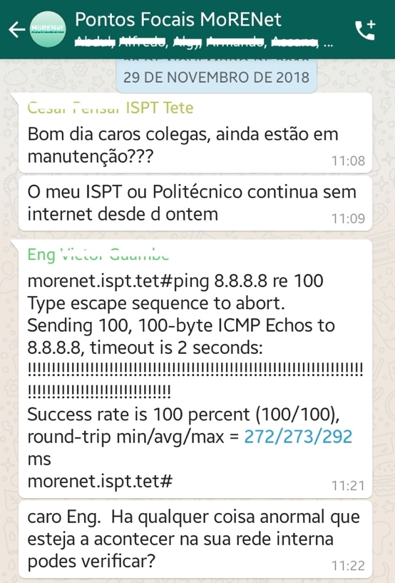
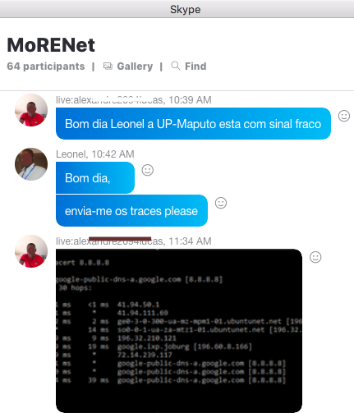
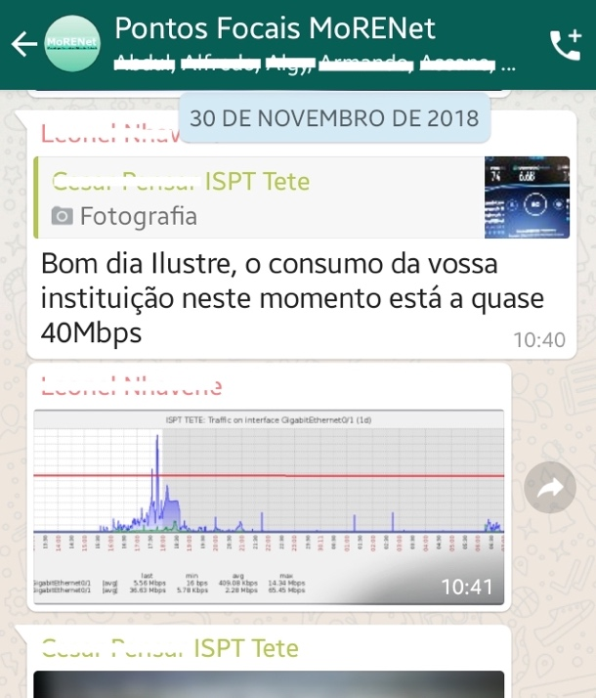
4. Case Study: MoRENet Academy
Findings
Help Desk Information – Network Operation Center
Notifications: level of difficulties from focal points;
Complaint level → kind of limitations;
Reporting same issues, multiple times, from multiple institutions;
Difficulties on performing simple tests/troubleshooting;
Institutions not reporting but having many difficulties.
Inputs for designing and planning trainings

Slide 13


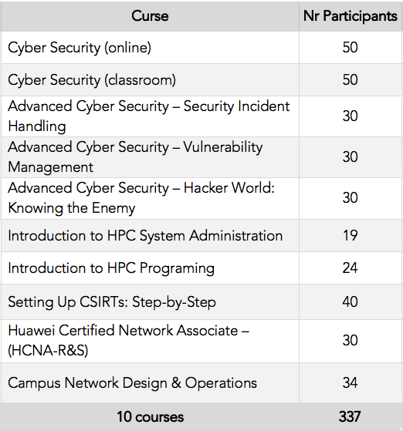
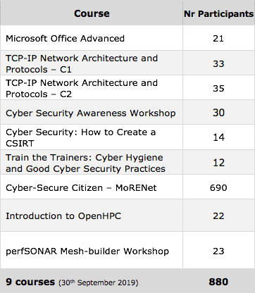







4. Case Study: MoRENet Academy
Findings
Training Results – MoRENet Academy
Special thanks to:
Training in 2018
Training in 2019
Type | Courses | Participants
Classroom | 8 | 247
Online | 2 | 90
Total | 10 | 337
Type | Courses | Participants
Classroom | 8 | 190
MOOC | 1 | 690
Total | 9 | 880

Slide 14
4. Case Study: MoRENet Academy
Results
1. Questionnaire to beneficiary institutions
More Focal Points have academic level in ICTs;
Focal points more skilled on General ICT;
Limited skills on Linux/Unix, server/virtualization and networking;
Gender
Female | 11 | 13%
Male | 74 | 87%
Total | 85 | 100%
Type of Institutions
Higher Education | 47 | 55%
Research | 15 | 18%
TVET | 23 | 27%
Total | 85 | 100%
Total | 85 | 100%

Slide 15
4. Case Study: MoRENet Academy
Results
2. MoRENet Training Results: 2018
2018 MoRENet Academy was stablished;
337 trained, 10 courses (8 classroom, 1 online, 1 distance);
Becomes Huawei Certified Academy (HAINA: Huawei Authorized Information and Network Academy);
1st ICT competition (+800 registered, 200 reached national phase, 18 HCNA certification).
Gender
Female | 35 | 10%
Male | 302 | 90%
Total | 337 | 100%
Area / Subject | Courses |  |  | Participants
Cyber Security | 6 | 60% |  | 230 | 68%
Networking | 2 | 20% |  | 64 | 19%
HPC | 2 | 20% |  | 43 | 13%
Total | 10 | 100% |  | 337 | 100%
Regime | Courses |  |  | Participants
Classroom | 8 | 80% |  | 247 | 73%
Distant | 1 | 10% |  | 50 | 15%
Online | 1 | 10% |  | 40 | 12%
Total | 10 | 100% |  | 337 | 100%

Slide 16
4. Case Study: MoRENet Academy
Results
2. MoRENet Training Results: 2019
2019 (up to September 2019);
Survey on training needs assessment;
+800 trained (target: 1,000);
9 courses (8 classroom + 1 MOOC);
2 ICT competitions (1 cyber security, 1 networking);
Awarded Best Huawei Academy.
Area / Subject | Courses |  |  | Participants
Cyber Security | 4 | 45% |  | 749 | 85%
Networking | 3 | 33% |  | 91 | 10%
HPC | 1 | 11% |  | 22 | 3%
MS Office | 1 | 11% |  | 21 | 2%
Total | 10 | 100% |  | 337 | 100%
Regime | Courses |  |  | Participants
Classroom | 8 | 89% |  | 190 | 22%
Online | 1 | 11% |  | 690 | 78%
Total | 9 | 100% |  | 880 | 100%

Slide 17
4. Case Study: MoRENet Academy
Results
2. MoRENet Training Results (Global: 2018 & 2019)
 | Nr Participants | Nr Courses
Year 2018 | 337 | 10
EaD | 50 | 1
Online | 40 | 1
Classroom | 247 | 8
Year 2019 | 880 | 9
MOOC | 690 | 1
Classroom | 190 | 8
Total | 1,217 | 19

Slide 18
4. Case Study: MoRENet Academy
Results
3. Professional internship program at MoRENet
MoRENet Academy program to:
Address HR shortage at MoRENet;
Capacity building and training – prepare the youth to the first job;
Support finalist students in their final course work;
Support finding their first job (paid internships) at MoRENet and ICT companies;
Actually:
3 internship stages: finalist university students, unpaid, paid internship;
13 interns (7 university, 2 unpaid, 4 paid);
1 already employed (young woman).

Slide 19
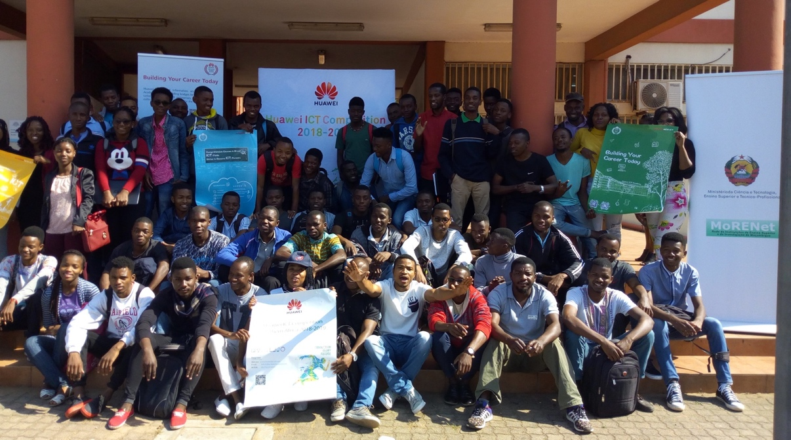
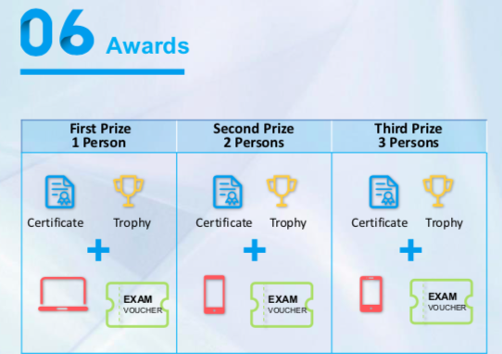
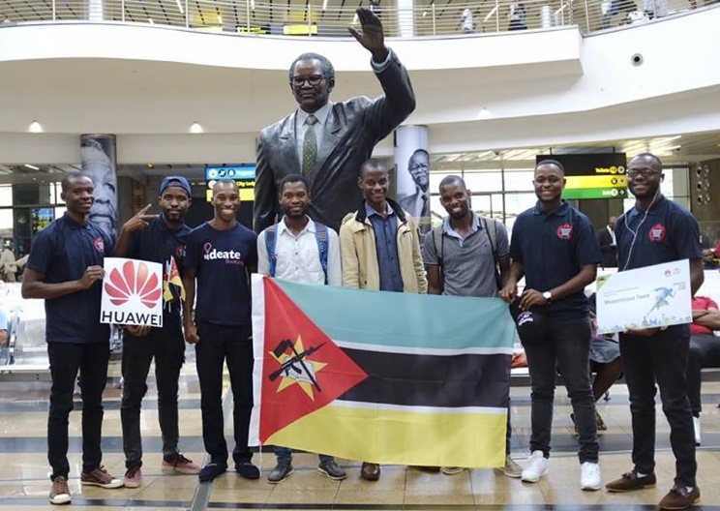
4. Case Study: MoRENet Academy
Results
4. ICT Competitions
ICT competition 2018-2019
MoU MoRENet and Huawei: August 2018;
Launched & registration: August 2018;
+880 registered, 264 preliminary, 85 national phase, 18 approved at national), 3 best to regional phase;
18 approved at national exam → Certificate HCNA;
Best 11 awarded (laptop, mobile phones, trophies, …
Best 3 → offered internship at Huawei Mozambique.

Slide 20

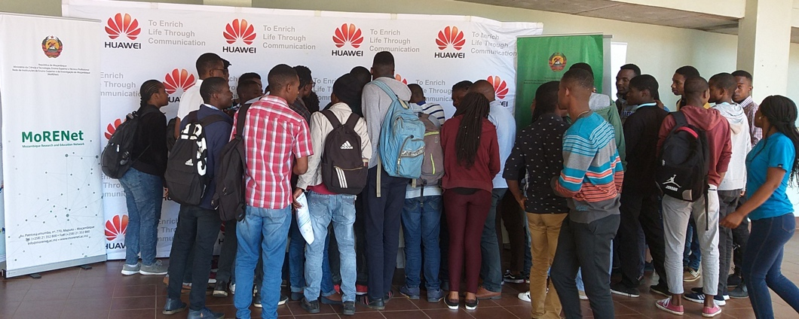

4. Case Study: MoRENet Academy
Results
4. ICT Competitions
ICT competition 2019-2020
Launched in June 2019 (HE Minister of C&T and China Ambassador);
+1,100 already registered;
Exam in November (preliminary), December (National), Feb. 2020 (Regional), May 2010 (Global);
Best 50 (national phase) → professional internship at Huawei, MoRENet and mobile companies.
Cyber Security Challenge 2019
SANReN & CHPC initiative;
MoRENet invited do participate → Moz universities;
103 Moz students registered (10 universities);
1 Moz team selected to final phase (December 2019).

Slide 21
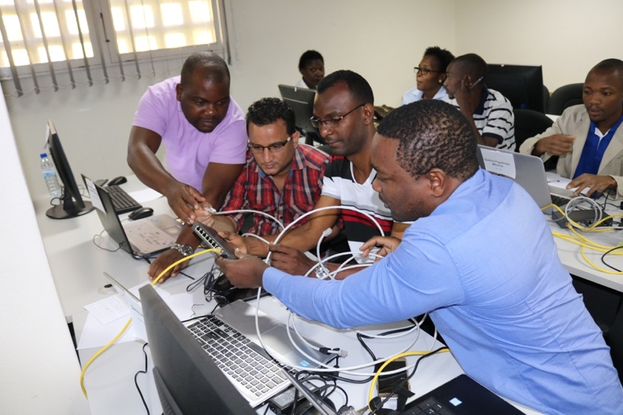
4. Case Study: MoRENet Academy
Challenges, Opportunities, and Plans
Provide training for 2+ IT for each connected institutions (160 + institutions);
Trainings on those areas with low knowledge level (Linux, Networking, Security) + specific NREN subjects;
Training in Emerging Digital Technologies and their Application for Research and Education Space (Artificial Intelligence, Cloud Services, eLearning Platforms (Moodle), Training in IoT, BlockChain, etc.);
Training in the delivery and management of eLearning Course and blended learning material for teachers and researchers.
MoRENet Academy Challenges:
Expand the coverage nationwide: 11 provinces, +100 institutions, +250 focal points, + end users,…
Budget to organize trainings;
Start charging for the courses;
Hire permanent trainers;
Establish online content production labs;
Professional certifications.

Slide 22
5. Results and Findings
Based on the findings and results
Limitations faced:
Need to reach large number of beneficiaries;
Need to attend geographically dispersed learners;
Limited resources to travel;
Limited time (trainers and learners);
Difficulty to attend courses on specific dates with a fixed schedule;
New subjects & services coming.
Use collaboration tools to deliver trainings:
Online trainings
Video and audio conferencing tools – webinars
Blended training (technical/practical subjects)
Blended learning: combine online lessons + classroom methods + online feedback and assessment → collaborative tools incorporated into lessons.
“e-learning is not ideal for all purposes, it is unlikely that it will replace classroom training completely” (Beatrice & FAO, 2011)

Slide 23
6. Conclusions
The IT staff at beneficiary institutions (focal points) are the key actors to deliver NREN’s services to reach the end users, with the desired quality and availability;
To address the quality and service availability, NREN’s need to focus on training the main players at beneficiary institution;
New services, volume tasks, new or updated services, are additional challenges for those professionals we depend on;
Due to high demand for training – online training solutions can address the issue;
In addition to online training solutions, blended learning (with collaboration tools) – are the way forward and solution to be adopted;
In the context of changes and new approaches, new tools need to be found to overcome old and chronic problems on trainings.

Slide 24
Obrigado
academia@morenet.ac.mz | lourino.chemane@morenet.ac.mz | moises.mucelo@morenet.ac.mz

