Slide 1
TECHNOLOGY INFRASTRUCTURE AS A KEY ENABLER FOR SUSTAINING TEACHING AND LEARNING DURING THE COVID-19 PANDEMIC.
ENG. MAINFORD MUTANDAVARI
FADZAYI SIBOTSHIWE

Slide 2
Introduction
The corona virus disease (COVID-19) pandemic, as well as the associated lockdown and physical separation measures, not only created unprecedented disruption in the delivery of teaching and learning, but also catalysed innovation in online education.
Education is critical to a country's economy, and many nations' educational models have developed, with digital infrastructure being viewed as the key enabler for sustaining teaching and learning during and after the COVID 19 epidemic.
Technology can be a powerful tool for transforming learning. It can help affirm and advance relationships between educators and students, reinvent our approaches to learning and collaboration, shrink long-standing equity and accessibility gaps, and adapt learning experiences to meet the needs of all learners.

Slide 3
Technology Infrastructure
To provide students with the education they need to thrive in a globally connected world, we must find ways to design, fund, acquire, and maintain the infrastructure that will make connectivity a reality for every teacher and student in every classroom.
Technology is at the core of virtually every aspect of our daily lives and work, and we must leverage it to provide engaging and powerful learning experiences and content, as well as resources and assessments that measure student achievement in more complete, authentic, and meaningful ways.
Technological infrastructure is just one element of educational transformation. Its use should be guided by clear goals and effective planning, which require that stakeholders in the system act together and plan beyond technology alone.
Education leaders should set a vision for creating learning experiences that provide the right tools and supports for all learners to thrive.

Slide 4
Technology Infrastructure
Learning, teaching, and assessment enabled by technology require a robust infrastructure
Key elements of this infrastructure include high-speed connectivity and devices that are available to teachers and students when they need them.
Aside from wires and devices, a comprehensive learning infrastructure includes digital learning content and other resources as well as professional development for educators and education leaders

Slide 5
Educational Technology
Technology-supported learning enables students to create multimedia, to collaborate with experts and learners across the world, and to employ tools to access deeper, more personalized learning, which, in turn, helps them become more college- and career-ready.
Teachers, parents, and students are looking for schools to provide high-quality, sustainable, dependable learning tools and cutting-edge connectivity.
One of the most important aspects of technology in education is its ability to level the field of opportunity for students.

Slide 6
Educational Technology
Equity and Accessibility :
  Equity in education means increasing all students’ access to educational opportunities with a focus on closing achievement gaps and removing barriers that students face based on their race, ethnicity, or national origin; sex; sexual orientation or gender identity or expression; disability; English language ability; religion; socioeconomic status; or geographical location.
  Accessibility refers to the design of apps, devices, materials, and environments that support and enable access to content and educational activities for all learners. In addition to enabling students with disabilities to use content and participate in activities, the concepts also apply to accommodating the individual learning needs of students, such as students in rural communities, or from economically disadvantaged homes.
  Technology can support accessibility through embedded assistance, for example, text-to-speech, audio and digital text formats of instructional materials, programs that differentiate instruction, adaptive testing, built-in accommodations, and assistive technology.

Slide 7
Educational Technology
When carefully designed and thoughtfully applied, technology can accelerate, amplify, and expand the impact of effective teaching practices.
However, to be transformative, educators need to have the knowledge and skills to take full advantage of technology-rich learning environments .
Education leaders need to create a shared vision for how technology best can meet the needs of all learners and to develop a plan that translates the vision into action.
Technology-enabled assessments support learning and teaching by communicating evidence of learning progress and providing insights to teachers; administrators; families; and, most importantly, the learners themselves.
These assessments can be embedded within digital learning activities to reduce interruptions to learning time

Slide 8
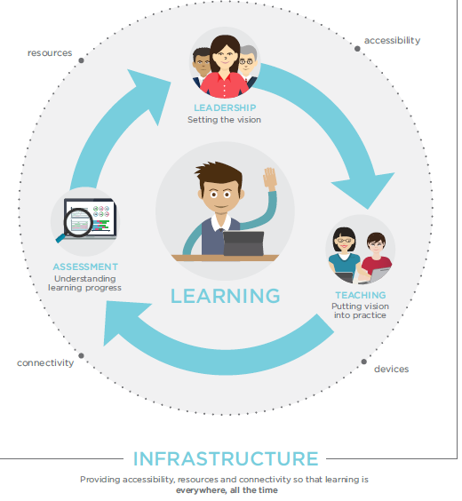
Fitting The Pieces Together

Slide 9
Opportunities
The conversation has shifted from whether technology should be used in learning to how it can improve learning to ensure that all students have access to high-quality educational experiences.
Technology increasingly is being used to personalize learning and give students more choice over what and how they learn and at what pace, preparing them to organize and direct their own learning for the rest of their lives.
Through pre-service teacher preparation programs and professional learning, educators are gaining experience and confidence in using technology to achieve learning outcomes.

Slide 10
Opportunities
Sophisticated software has begun to allow us to adapt assessments and instruction to the needs and abilities of individual learners and provide near real-time results.
Regionally, significant progress has been made toward ensuring that every school has high-speed classroom connectivity as a foundation for other learning innovations.
Technology has allowed us to rethink the design of physical learning spaces to accommodate new and expanded relationships among learners, teachers, peers, and mentors.

Slide 11
Challenges: Digital Use Divide
Traditionally, the digital divide referred to the gap between students who had access to the Internet and devices at school and home and those who did not.
Significant progress is being made to increase internet access in schools, libraries, and homes across the country.
However, a digital use divide separates many students who use technology in ways that transform their learning from those who use the tools to complete the same activities but now with an electronic device (e.g., digital worksheets, online multiple-choice tests).
The digital use divide is present in both formal and informal learning settings and across high- and low-poverty schools and communities.

Slide 12
Challenges
A digital use divide continues to exist between learners who are using technology in active, creative ways to support their learning and those who predominantly use technology for passive content consumption.
While school, college and university leaders often leverage data for decision-making, many still need support and better tools so they can get real-time information on how strategies are working through rigorous, quick-turnaround evaluations of technology.
Many schools and institutions do not yet have access to or are not yet using technology in ways that can improve learning on a daily basis, which underscores the need guided by new research to accelerate and scale up adoption of effective approaches and technologies.
Schools, colleges and universities that are deciding how to incorporate educational technology in student learning should actively involve and engage families during early development and implementation of their digital transformation.

Slide 13
Challenges
As students use technology to support their learning, schools are faced with a growing need to protect student privacy continuously while allowing the appropriate use of data to personalize learning, advance research, and visualize student progress for families and teachers.
Network security is a growing concern as internet accessible school data, management, and learning systems become more ubiquitous and as the sophistication of attacks on school networks grows, including the use of ransom ware.

Slide 14
Learning
Goal : All learners will have engaging and empowering learning experiences in both formal and informal settings that prepare them to be active, creative, knowledgeable, and ethical participants in our globally connected society.

Slide 15
Ways technology can improve and enhance Learning,
Technology can enable personalized learning or experiences that are more engaging and relevant.
Technology can help organize learning around real-world challenges and project-based learning – using a wide variety of digital learning devices and resources to show competency with complex concepts and content.
Technology can help learning move beyond the classroom and take advantage of learning opportunities available in museums, libraries, and other out-of-school settings.
Technology can help learners pursue passions and personal interests.
Technology access when equitable can help close the digital divide and make transformative learning opportunities available to all learners.

Slide 16
Learning
Project-based learning takes place in the context of authentic problems, continues over time, and brings in knowledge from many subjects. Project-based learning, if properly implemented and supported, helps students develop 21st century skills including creativity, collaboration, and leadership and engages them in complex, real-world challenges that help them meet expectations for critical thinking.
While essential, closing the digital divide alone will not transform learning. We must also close the digital use divide by ensuring all students understand how to use technology as a tool to engage in creative, productive, life-long learning rather than simply consuming passive content.

Slide 17
Teaching
Goal: Educators will be supported by technology that connects them to people, data, content, resources, expertise, and learning experiences that can empower and inspire them to provide more effective teaching for all learners.

Slide 18
Roles and Practices of Educators in Technology-Supported Learning
Educators can collaborate far beyond the walls of their schools.
Educators can design highly engaging and relevant learning experiences through technology.
Educators can lead the evaluation and implementations of new technologies for learning.
Educators can be guides, facilitators, and motivators of learners.
Educators can be co-learners with students and peers.
Educators can become catalysts to serve the underserved.

Slide 19
Leadership: Creating a Culture and Conditions for Innovation and Change
Goal: Embed an understanding of technology-enabled education within the roles and responsibilities of education leaders at all levels and set state, regional, and local visions for technology in learning

Slide 20
Characteristics of Effective Leadership
Collaborative Leadership
Personalized Student Learning
Robust Infrastructure
Personalized Professional Learning
Ensure Long-Term Sustainability

Slide 21
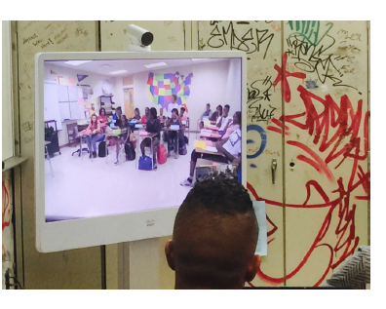
Implementation is Key

Slide 22
Infrastructure Enabling Access and Effective Use
Goal: All students and educators will have access to a robust and comprehensive infrastructure when and where they need it for learning.

Slide 23
Essential components of an Infrastructure
The essential components of an infrastructure capable of supporting transformational learning experiences include the following:
  Ubiquitous connectivity. Persistent access to high-speed internet in and out of school
  Powerful learning devices. Access to mobile devices that connect learners and educators to the vast resources of the internet and facilitate communication and collaboration
  High-quality digital learning content. Digital learning content and tools that can be used to design and deliver engaging and relevant learning experiences
  Responsible Use Policies (RUPs). Guidelines to safeguard students and ensure that the infrastructure is used to support learning

Slide 24
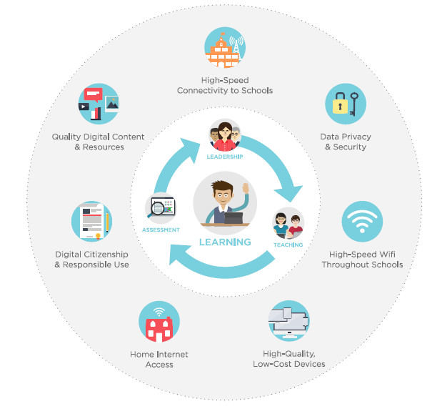

Slide 25
Recommendations
Set a vision for the use of technology to enable learning such that leaders bring all stakeholder groups to the table, including students, educators, families, technology professionals, community groups, cultural institutions, and other interested parties.
Research and development should be conducted that explores how embedded assessment technologies such as simulations, collaboration environments, virtual worlds, games, and cognitive tutors can be used to engage and motivate learners while assessing complex skills.
Ensure that every student and educator has at least one internet access device and appropriate software and resources for research, communication, multimedia content creation, and collaboration for use in and out of school.

Slide 26
Recommendations
Institutions should develop and implement learning resources that embody the flexibility and power of technology to create equitable and accessible learning ecosystems that make learning possible everywhere and all the time for all students.
Draft sustainability plans for infrastructure concerns that include upgrades of wired and wireless access as well as device refresh plans and sustainable funding sources while ensuring the safety and protection of student data.

Slide 27
Conclusion
The timing has never been better for using technology to enable and improve learning at all levels, in all places, and for people of all backgrounds.
Educators, policymakers, administrators, and teacher preparation and professional development programs now should embed these tools and resources into their practices.
Working in collaboration with families, researchers, cultural institutions, and all other stakeholders, these groups can eliminate inefficiencies, reach beyond the walls of traditional classrooms, and form strong partnerships to support everywhere, all-the-time learning.

